Slide 1
CS 371
Artificial Intelligence
Fall 2023

Slide 2


Slide 3

Search (II)

Slide 4


Definition: search problem
s_{start}: starting state
Actions(s): possible actions from state s
Cost(s, a): action cost
transition(s, a): Find Next State given current State and Action
IsGoal(s): reached goal state?
Objective
find the minimum cost path from s_{start} to an s satisfying that we have reached on the goal state i.e. isGoal(s) is true.

Slide 5

Key idea: state
A state is a summary of all the past actions sufficient to choose future actions optimally.

Slide 6
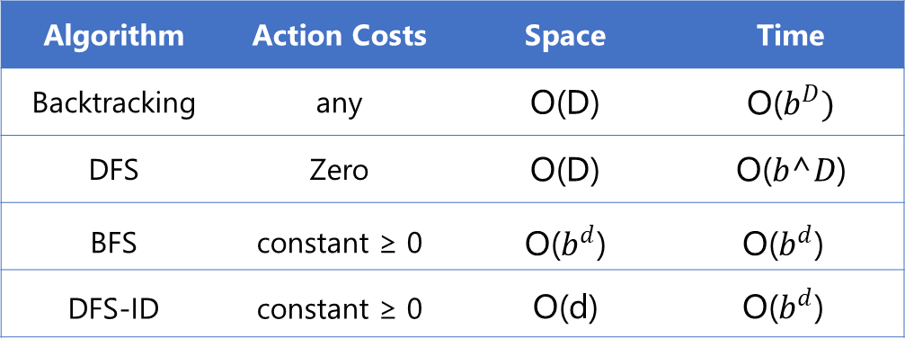
Tree search algorithms
Legend: $b$ actions/state, solution depth d, maximum depth D
Algorithm | Action Costs | Space | Time
Backtracking | any | O(D) | O($b^{D})$
DFS | Zero | O(D) | O(𝑏^𝐷)
BFS | constant ≥ 0 | O($b^{d}$) | O($b^{d}$)
DFS-ID | constant ≥ 0 | O(d) | O($b^{d}$)
Always exponential time
Avoid exponential space with DFS-ID
Notes:
Here is a summary of all the tree search algorithms, the assumptions on the action costs, and the space and time complexities.
The take-away is that we can’t avoid the exponential time complexity, but we can certainly have linear space complexity. Space is in some sense the more critical dimension in search problems. Memory cannot magically grow, whereas time ”grows” just by running an algorithm for a longer period of time, or even by parallelizing it across multiple machines (e.g., where each processor gets its own subtree to search).

Slide 7
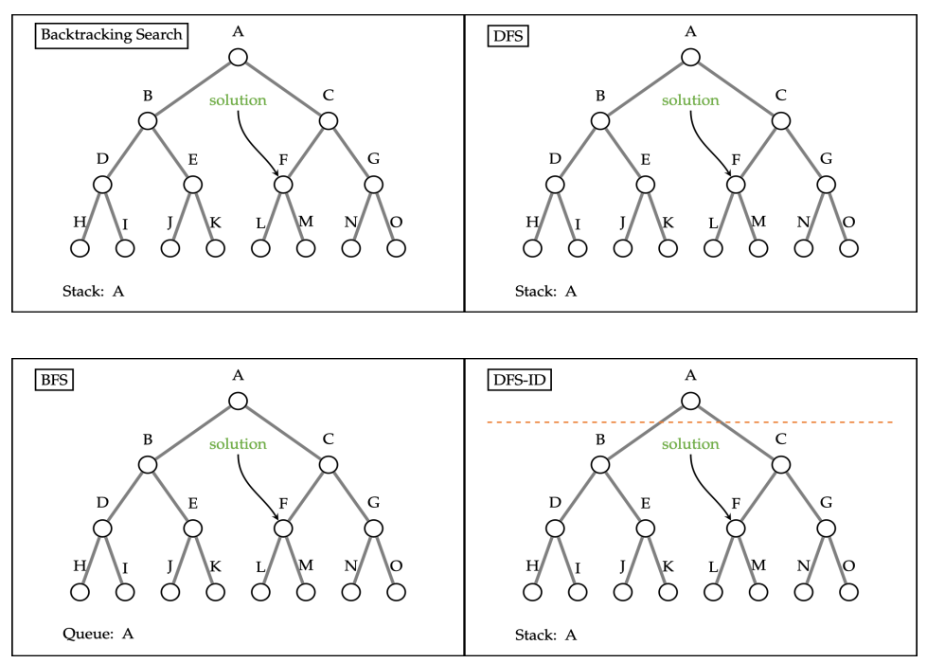
Tree Search Review

Slide 8
Definition: Transportation Example
Move from state 1 to n moving forward
Start state: 1
Walk action: from s to s + 1 (cost: 1)
Tram action: from s to 2s (cost: 2)
End state: n
State:
current city

Slide 9
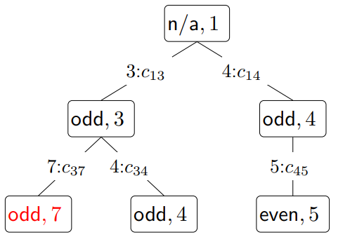

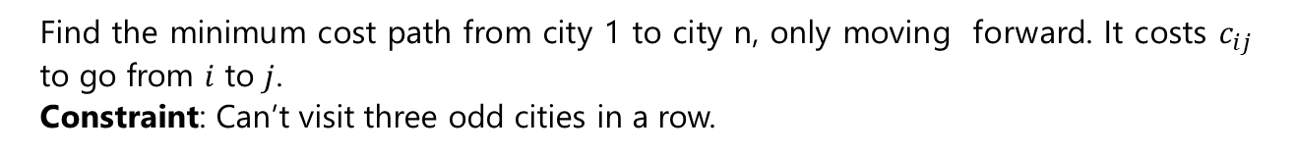
Handling additional constraints
Example: Route finding
Find the minimum cost path from city 1 to city n, only moving forward. It costs $c_{ij}$ to go from $i$ to $j$.
Constraint: Can’t visit three odd cities in a row.
What will the state definition?
How many Minimum states are possible?
State: (whether previous city was odd,
current city)
Notes:
Let’s add a constraint that says we can’t visit three odd cities in a row. If we only keep track of the current city, and we try to move to a next city, we cannot enforce this constraint because we don’t know what the previous city was. So let’s add the previous city into the state.
This will work, but we can actually make the state smaller. We only need to keep track of whether the previous city was an odd numbered city to enforce this constraint.
Note that in doing so, we have 2n states rather than n² states, which is a substantial savings. So the lesson is to pay attention to what information you actually need in the state.

Slide 10

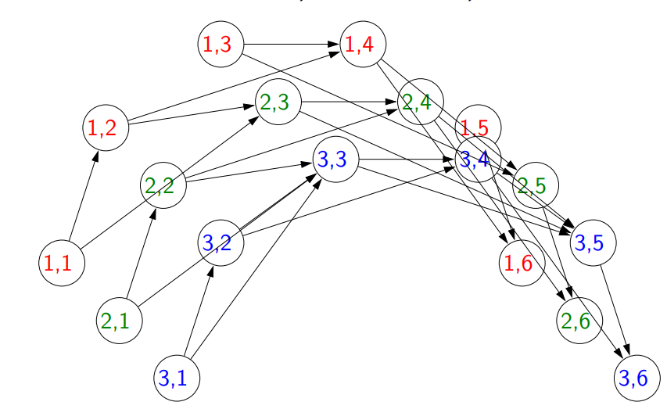
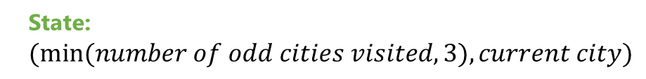
Activity
Objective
travel from city 1 to city n, visiting at least 3 odd cities. What is the minimal state?
State: $(min⁡(number of odd cities visited, 3), current city)$

Slide 11

Exercise
Objective
travel from city 1 to city n, visiting more odd than even cities. What is the minimal state?

Slide 12
Take Away
State: summary of past actions sufficient to choose future actions optimally
Dynamic programming: backtracking search with memorization — potentially exponential savings
Dynamic programming only works for
acyclic graphs. what if there are cycles?

Slide 13
Uniform Cost Search

Slide 14
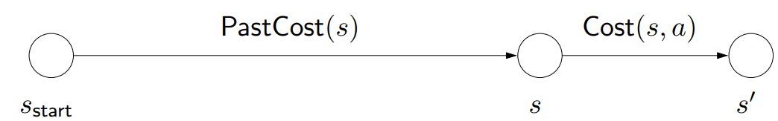
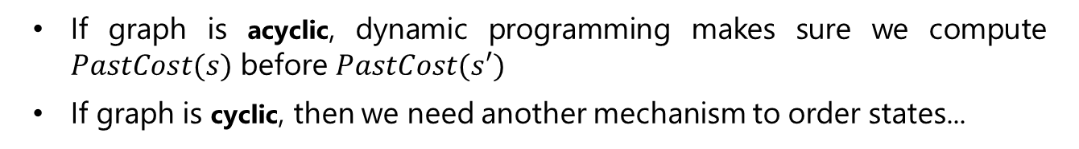
Ordering the states
Observation: prefixes of optimal path are optimal
If graph is acyclic, dynamic programming makes sure we compute $PastCost(s)$ before $PastCost(s′)$
If graph is cyclic, then we need another mechanism to order states...
Notes:
Recall that we used dynamic programming to compute the future cost of each state s, the cost of the minimum cost path from s to a end state.
We can analogously define PastCost(s), the cost of the minimum cost path from the start state to s. If instead of having access to the successors via Succ(s, a), we had access to predecessors (think of reversing the edges in the state graph), then we could define a dynamic program to compute all the PastCost(s).
Dynamic programming relies on the absence of cycles, so that there is always a clear order in which to compute all the past costs. If the past costs of all the predecessors of a state s are computed, then we could compute the past cost of s by taking the minimum.
Note that PastCost(s) will always be computed before PastCost(s′) if there is an edge from s to s′. In essence, the past costs will be computed according to a topological ordering of the nodes.
However, when there are cycles, no topological ordering exists, so we need another way to order the states.

Slide 15
Intuition from Dijkstra Algorithm
Aside

Slide 16
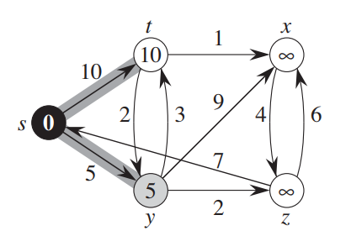
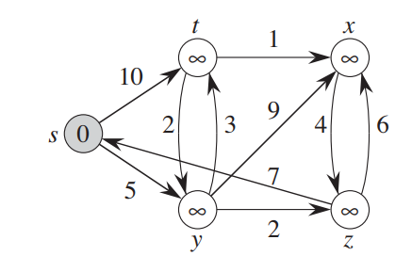
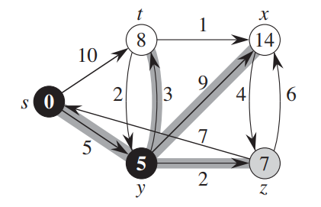

Slide 17
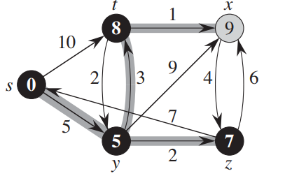
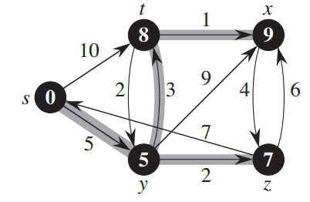
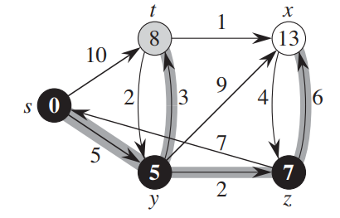

Slide 18
End Aside
Dijkstra
Stop on Goal
Uniform Cost Search

Slide 19
Uniform cost search (UCS)
Key idea: state ordering
UCS enumerates states in order of increasing past cost.
Assumption: non-negativity
All action costs are non-negative: Cost(s, a) ≥ 0.
Notes:
The key idea that uniform cost search (UCS) uses is to compute the past costs in order of increasing past cost. To make this efficient, we need to make an important assumption that all action costs are non-negative.
This assumption is reasonable in many cases, but doesn’t allow us to handle cases where actions have payoff. To handle negative costs (positive payoffs), we need the Bellman-Ford algorithm. When we talk about value iteration for MDPs, we will see a form of this algorithm.
Note: those of you who have studied algorithms should immediately recognize UCS as Dijkstra’s algorithm.
Logically, the two are indeed equivalent. There is an important implementation difference: UCS takes as input a search problem, which implicitly defines a large and even infinite graph, whereas Dijkstra’s algorithm (in the typical exposition) takes as input a fully concrete graph. The implicitness is important in practice because we might be working with an enormous graph (a detailed map of world) but only need to find the path between two close by points (Stanford to Palo Alto).
Another difference is that Dijkstra’s algorithm is usually thought of as finding the shortest path from the start state to every other node, whereas UCS is explicitly about finding the shortest path to an end state. This difference is sharpened when we look at the A* algorithm next time, where knowing that we’re trying to get to the goal can yield a much faster algorithm. The name uniform cost search refers to the fact that we are exploring states of the same past cost uniformly (the video makes this visually clear); in contrast, A* will explore states which are biased towards the end state.

Slide 20
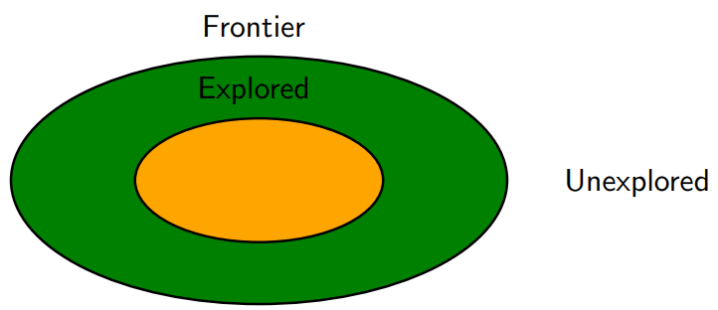
High-level strategy
Explored(Black): states we’ve found the optimal path to
Frontier(grey): states we’ve seen, still figuring out how to get there cheaply
Unexplored(white): states we haven’t seen
Notes:
The general strategy of UCS is to maintain three sets of nodes: explored, frontier, and unexplored. Throughout the course of the algorithm, we will move states from unexplored to frontier, and from frontier to explored.
The key invariant is that we have computed the minimum cost paths to all the nodes in the explored set. So when the end state moves into the explored set, then we are done.

Slide 21
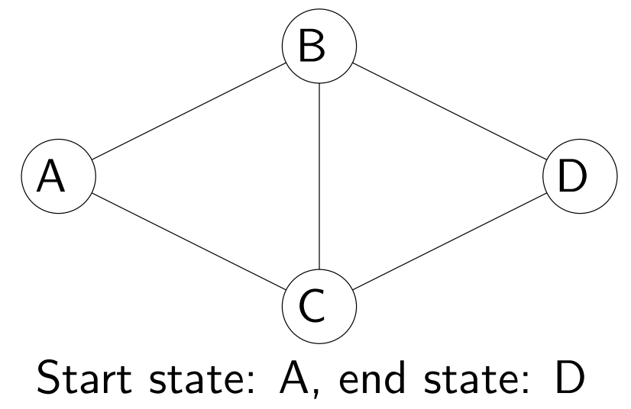
Uniform cost search example
Example: UCS example
Minimum cost path:
$$A → B → C → D with cost 3$$
Notes:
Before we present the full algorithm, let’s walk through a concrete example.
Initially, we put A on the frontier. We then take A off the frontier and mark it as explored. We add B and C to the frontier with past costs 1 and 100, respectively.
Next, we remove from the frontier the state with the minimum past cost (priority), which is B. We mark B as explored and consider successors A, C, D. We ignore A since it’s already explored. The past cost of C gets updated from 100 to 2. We add D to the frontier with initial past cost 101.
Next, we remove C from the frontier; its successors are A, B, D. A and B are already explored, so we only update D’s past cost from 101 to 3.
Finally, we pop D off the frontier, find that it’s a end state, and terminate the search.

Slide 22
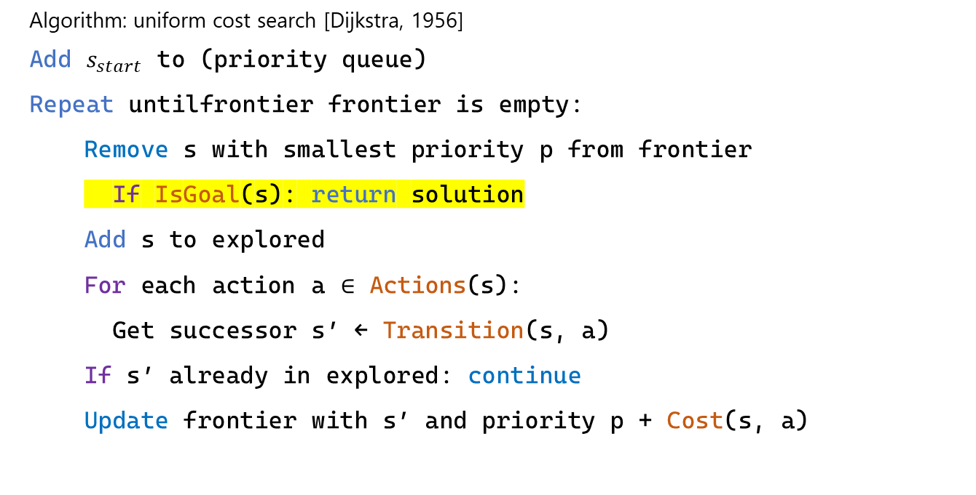
Uniform cost search (UCS)
Algorithm: uniform cost search [Dijkstra, 1956]
Add $s_{start}$ to (priority queue)
Repeat untilfrontier frontier is empty:
  Remove s with smallest priority p from frontier
  If IsGoal(s): return solution
  Add s to explored
  For each action a ∈ Actions(s):
  Get successor s′ ← Transition(s, a)
  If s′ already in explored: continue
  Update frontier with s′ and priority p + Cost(s, a)
Notes:
Implementation note: we use util.PriorityQueue which supports removeMin and update. Note that frontier.update(state, pastCost) returns whether pastCost improves the existing estimate of the past cost of state.

Slide 23
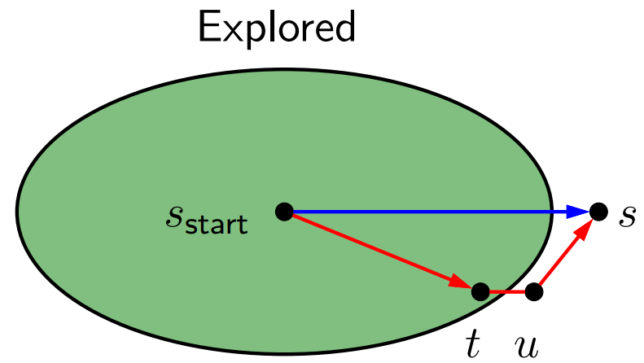
Analysis of uniform cost search
Theorem: correctness
When a state $s$ is popped from the frontier and moved to explored, its priority is $PastCost(s)$, the minimum cost to $s$.
Proof:
Notes:
Let p_{s} be the priority of s when s is popped off the frontier. Since all costs are non-negative, p_{s} increases over the course of the algorithm.
Suppose we pop s off the frontier. Let the blue path denote the path with cost p_{s}.
Consider any alternative red path from the start state to s. The red path must leave the explored region at some point; let t and u = Succ(t, a) be the first pair of states straddling the boundary. We want to show that the red path cannot be cheaper than the blue path via a string of inequalities.
First, by definition of PastCost(t) and non-negativity of edge costs, the cost of the red path is at least the cost of the part leading to u, which is PastCost(t) + Cost(t, a) = p_{t} + Cost(t, a), where the last equality is by the inductive hypothesis.
Second, we have p_{t} + Cost(t, a) ≥ p_{u} since we updated the frontier based on (t, a).
Third, we have that p_{u} ≥ p_{s} because s was the minimum cost state on the frontier.
Note that p_{s} is the cost of the blue path.

Slide 24

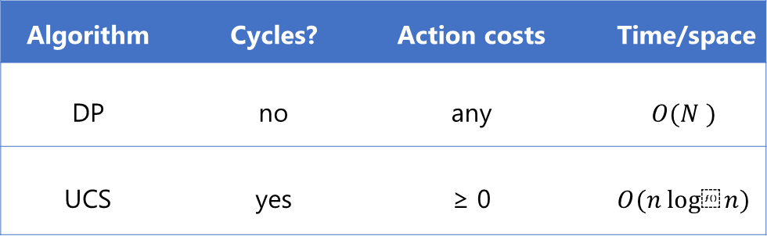
DP versus UCS
$N$ total states, $n$ of which are closer than end state
Algorithm | Cycles? | Action costs | Time/space
DP | no | any | $$O(N )$$
UCS | yes | ≥ 0 | $$O(n log⁡n)$$
Note:
UCS potentially explores fewer states, but requires more overhead to maintain the priority queue
Assume number of actions per state is constant (independent of $n$ and $N$ )
Notes:
DP and UCS have complementary strengths and weaknesses; neither dominates the other.
DP can handle negative action costs, but is restricted to acyclic graphs. It also explores all N reachable states from s_{start}, which is inefficient. This is unavoidable due to negative action costs.
UCS can handle cyclic graphs, but is restricted to non-negative action costs. An advantage is that it only needs to explore n states, where n is the number of states which are cheaper to get to than any end state. However, there is an overhead with maintaining the priority queue.
One might find it unsatisfying that UCS can only deal with non-negative action costs. Can we just add a
large positive constant to each action cost to make them all non-negative? It turns out this doesn’t work because it penalizes longer paths more than shorter paths, so we would end up solving a different problem.

Slide 25
Activity
Question
Suppose we want to travel from city 1 to city n (going only forward) and back to city 1 (only going backward).It costs c_{ij} ≥ 0 to go from i to
j. Which of the following algorithms can be used to find the minimum cost path (select all that apply)?
Depth First Search
Breadth First Search
Dynamic Programming
Uniform Cost Search

Slide 26
1
2
3
4
5
6
7
8
…
n
What will be the state here
1
2
3
4
…
n
…
4
3
2
1

Slide 27
Paradigm
Review
Major Pillars
Modeling
Learning
Inference

Slide 28

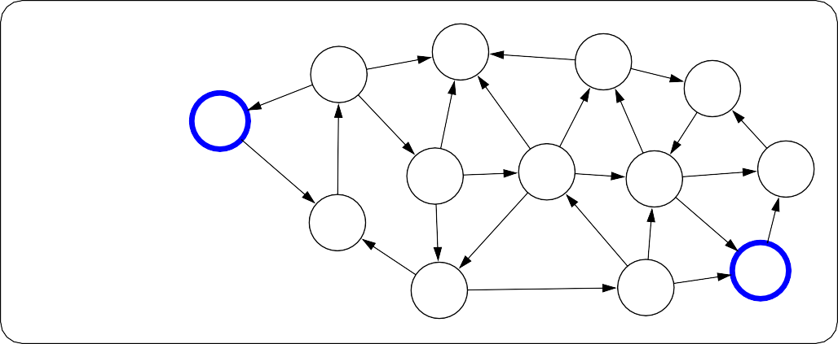
Paradigm
Modeling
Review
Real world
6
7
4
5
5
5
3
1
Model
0
8
6
3
8
8
1
1
7
2
3
6
7
2
4
8
6
Notes:
The first pillar is modeling. Modeling takes messy real world problems and packages them into neat formal mathematical objects called models, which can be subject to rigorous analysis and can be operated on by computers. However, modeling is lossy: not all of the richness of the real world can be captured, and therefore there is an art of modeling: what does one keep versus ignore? (An exception to this are games such as Chess, Go or Sodoku, where the real world is identical to the model.)
As an example, suppose we’re trying to have an AI that can navigate through a busy city. We might formulate this as a graph where nodes represent points in the city, edges represent the roads, and the cost of an edge represents the traffic on that road.

Slide 29

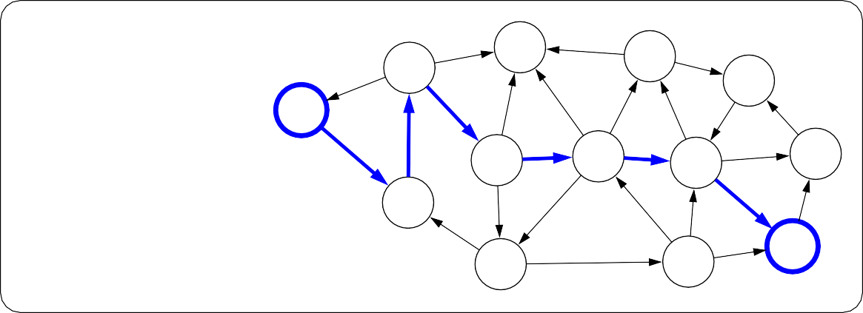
Review
Paradigm
Inference
6
7
4
5
5
5
3
1
Model
0
8
6
3
8
8
1
1
7
2
3
6
7
2
4
8
6
Inference
6
7
4
5
8
5
5
3
1
Predictions
0
6
3
8
8
1
1
7
2
3
6
7
2
4
8
6
Notes:
The second pillar is inference. Given a model, the task of inference is to answer questions with respect to the model. For example, given the model of the city, one could ask questions such as: what is the shortest path? what is the cheapest path?
The focus of inference is usually on efficient algorithms that can answer these questions. For some models, computational complexity can be a concern (games such as Go), and usually approximations are needed.

Slide 30
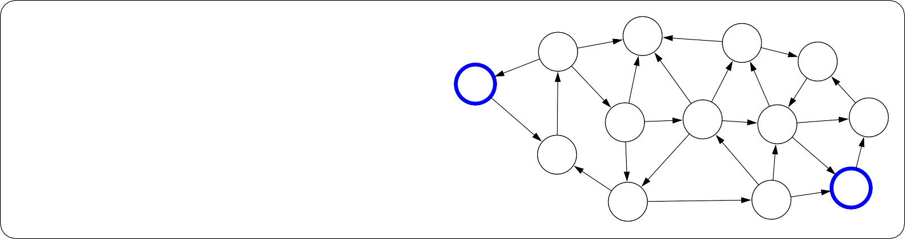
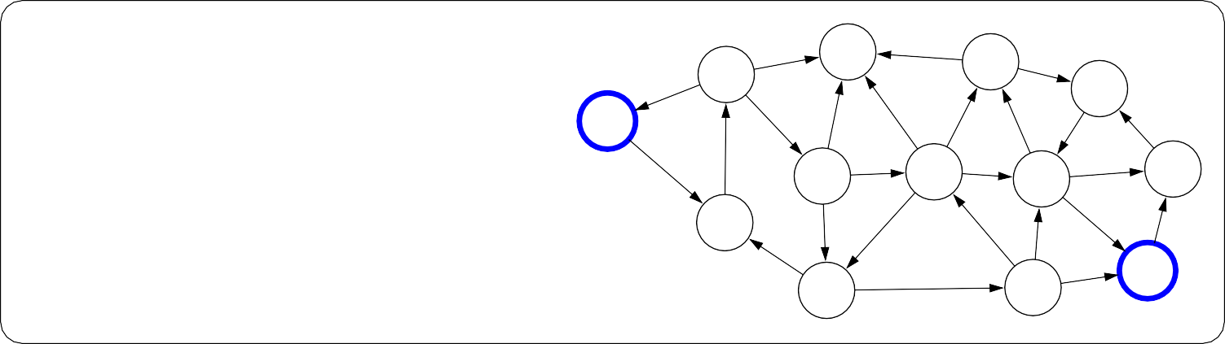
Review
Paradigm
Learning
?
?
?
?
?
?
?
?
Model without parameters
?
?
?
?
+ Data
?
?
?
?
?
?
?
?
?
?
?
?
?
Learning
6
7
4
5
5
5
3
1
Model with parameters
0
8
6
3
8
8
1
1
7
2
3
6
7
2
4
8
6
Notes:
But where does the model come from? Remember that the real world is rich, so if the model is to be faithful, the model has to be rich as well. But we can’t possibly write down such a rich model manually.
The idea behind (machine) learning is to instead get it from data. Instead of constructing a model, one constructs a skeleton of a model (more precisely, a model family), which is a model without parameters. And then if we have the right type of data, we can run a machine learning algorithm to tune the parameters of the model.
Note that learning here is not tied to a particular approach (e.g., neural networks), but more of a philosophy.
This general paradigm will allow us to bridge the gap between logic-based AI and statistical AI.

Slide 31
Learning Costs

Slide 32

Search Problem
Transportation Example
Move from state 1 to n moving forward
Start state: 1
Walk action: from s to s + 1 (cost: 1)
Tram action: from s to 2s (cost: 2)
End state: n
State:
current city
search algorithm
walk walk tram tram tram walk tram tram
(minimum cost path)

Slide 33
Learning Problem
Transportation Example
Move from state 1 to n moving forward
Start state: 1
Walk action: from s to s + 1 (cost: 1)
Tram action: from s to 2s (cost: 2)
End state: n
State:
current city
Learning algorithm
walk cost: 1 tram cost: 2
Notes:
Now suppose we don’t know what the costs are, but we observe someone getting from 1 to n via some sequence of walking and tram-taking. Can we figure out what the costs are? This is the goal of learning.

Slide 34
Learning as an inverse problem
Predictor
Forward problem (search):
Input
Search Problem
(cost of each action)
Output
Sequence of
Actions towards
optimal path
Cost(s, a)
(a₁, . . . , a_{k})
Inverse problem (learning):
Data
Examples containing
Optimal paths
(might contain some noise)
Learner
(a₁, . . . , a_{k})
Cost(s, a)
Predictor
Notes:
More generally, so far we have thought about search as a ”forward” problem: given costs, finding the optimal sequence of actions.
Learning concerns the ”inverse” problem: given the desired sequence of actions, reverse engineer the costs.

Slide 35
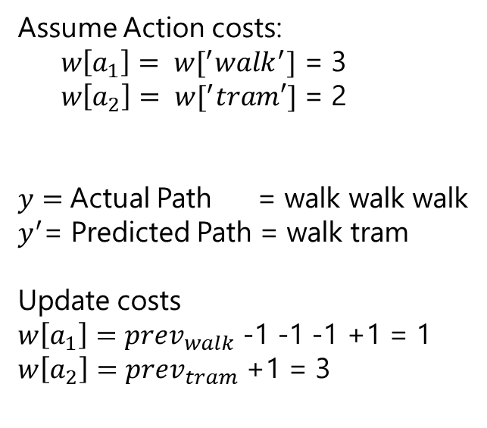


Learning as an inverse problem
Assume Action costs:
$w\left[a_{1}\right]= w[^{′}walk^{′}]$ = 3
$w\left[a_{2}\right]= w[^{′}tram′]$ = 2
$y=$Actual Path = walk walk walk
$y^{′}$= Predicted Path = walk tram
Update costs
$w\left[a_{1}\right]=$ $prev_{walk}$ -1 -1 -1 +1 = 1
$w\left[a_{2}\right]=prev_{tram}$ +1 = 3
Input x: search problem without costs
1
walk:?
2
walk:? tram:?
3
walk:?
4
4
Path Cost: $w\left[a_{1}\right]+w[a_{2}]$ =
3+2 = 5
Path Cost: $w\left[a_{1}\right]+w\left[a_{1}\right]+w[a_{1}]$ =
3+3 + 3 = 9
Output y: solution path
walk walk walk
Notes:
Let’s cast the problem as predicting an output y given an input x. Here, the input x is the search problem (visualized as a search tree) without the costs provided. The output y is the desired solution path. The question is what the costs should be set to so that y is actually the minimum cost path of the resulting search problem.

Slide 36
Costs: {walk:1, tram:3}
Minimum cost path:
1
walk:1
2
Costs: {walk:3, tram:2}
Minimum cost path:
1
walk:3
2
walk:3 tram:2
3
walk:3 4
Tweaking costs
walk:1 tram:3
3
walk:1
4
4
4
Notes:
Suppose the walk cost is 3 and the tram cost is 2. Then, we would obviously predict the [walk, tram] path, which has lower cost.
But this is not our desired output, because we actually saw the person walk all the way from 1 to 4. How can we update the action costs so that the minimum cost path is walking?
Intuitively, we want the tram cost to be more and the walk cost to be less. Specifically, let’s increase the
cost of every action on the predicted path and decrease the cost of every action on the true path. Now, the predicted path coincides with the true observed path. Is this a good strategy in general?

Slide 37
Modeling costs (simplified)
Assume costs depend only on the action:
Cost(s, a) = w[a]
Candidate output path:
y:
a₁ : w[a₁]
a₂ : w[a₂]
a₃ : w[a₃]
s₀
s₁
s₂
s₃
Path cost:
Cost(y) = w[a₁] + w[a₂] + w[a₃]
Notes:
For each action a, we define a weight w[a] representing the cost of action a. Without loss of generality, let us assume that the cost of the action does not depend on the state s.
Then the cost of a path y is simply the sum of the weights of the actions on the path. Every path has some cost, and recall that the search algorithm will return the minimum cost path.

Slide 38

Learning algorithm
Algorithm: Structured Perceptron
For each action: w[a] ← 0
For each iteration t = 1, . . . T :
  For each training example (x, y) ∈ D_{train}:
    Compute the minimum cost path y^{j} given w
    For each action a ∈ y: w[a] ← w[a] − 1
    For each action a ∈ y^{j}: w[a] ← w[a] + 1
Try to decrease cost of true y (from training data)
Try to increase cost of predicted y^{j} (from search)

Slide 39
Applications
Part-of-speech tagging
Fruit flies like a banana.
Noun Noun Verb Det Noun
Machine translation
la maison bleue
the blue house
Notes:
The structured Perceptron was first used for natural language processing tasks. Given it’s simplicity, the Perceptron works reasonably well. With a few minor tweaks, you get state-of-the-art algorithms for structured prediction, which can be applied to many tasks such as machine translation, gene prediction, information extraction, etc.
On a historical note, the structured Perceptron merges two relatively classic communities. The first
is search algorithms (uniform cost search was developed by Dijkstra in 1956). The second is machine learning (Perceptron was developed by Rosenblatt in 1957). It was only over 40 years later that the two met.

Slide 40
Transportation Problem
class TranportationProblem(object):
def __init__(self, N):
self.N = N
def startState(self):
return 1
def isGoal(self, state):
return state == self.N
def actions(self, state):
actions=[]
if(state+ 1 <= self.N):
actions.append('walk')
if(state *2<= self.N):
actions.append('tram')
return actions
def transition(self, state, action):
new_state = 0
if(action == 'walk'):
new_state = state + 1
elif(action =='tram'):
new_state = state *2
return new_state
def cost(self, action):
cost_val = 0
if(action == 'walk'):
cost_val = 1
elif(action =='tram'):
cost_val = 2
return cost_val

Slide 41
Transportation Problem
class TranportationProblem(object):
def __init__(self, N, weights):
self.N = N
self.weights = weights
def startState(self):
return 1
def isGoal(self, state):
return state == self.N
def actions(self, state):
actions=[]
if(state+ 1 <= self.N):
actions.append('walk')
if(state *2<= self.N):
actions.append('tram')
return actions
def transition(self, state, action):
new_state = 0
if(action == 'walk'):
new_state = state + 1
elif(action =='tram'):
new_state = state *2
return new_state
def cost(self, action):
cost_val = 0
if(action == 'walk'):
cost_val = self.weights['walk']
elif(action =='tram'):
cost_val = self.weights['tram']
return cost_val

Slide 42

Learning Problem in Action
Learning requires the correct examples against the output from the environment.
How we get these examples?

Slide 43

Generate the Data from the Environment
Data Generator
(knows the mechanism to do work)
Costs are hidden inside
N = 1: w
N= 2: w, t
N =3: w, w, w
…
…
N = 10: w, t, t, w
Observer

Slide 44
Data Generator in Action
def predict(N, weights):
# f(x)
# Input (x): N (number of blocks)
# Output (y): path (sequence of actions)
problem = TransportationProblem(N, weights)
totalCost, history = dynamicProgramming(problem)
return [action for action, newState, cost in history]
def generateExamples():
trueWeights = {'walk': 1, 'tram’: 2}
return [(N, predict(N, trueWeights)) for N in range(1, 10)]

Slide 45
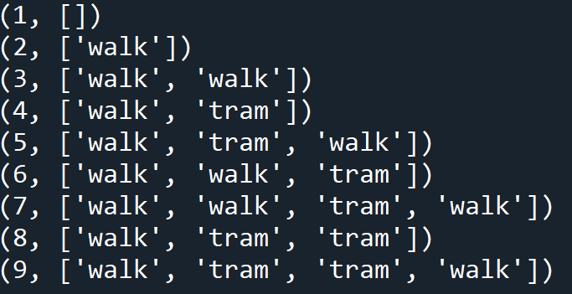
Data Generator for Transportation Problem (N = 10)
Walk: 1, Tram: 2

Slide 46
Structured Perceptron (Learning Algorithm)
def structuredPerceptron(examples):
weights = {'walk': 0, 'tram': 0}
for t in range(100):
numMistakes = 0
for N, trueActions in examples:
# Make a prediction
predActions = predict(N, weights)
if predActions != trueActions:
numMistakes += 1
# Update weights
for action in trueActions:
weights[action] -= 1
for action in predActions:
weights[action] += 1
print('Iteration {}, numMistakes = {}, weights = {}'.format(t, numMistakes, weights))
if numMistakes == 0:
break

Slide 47
Learning Transportation Problem (N = 10)
Walk: 1, Tram: 2

Slide 48
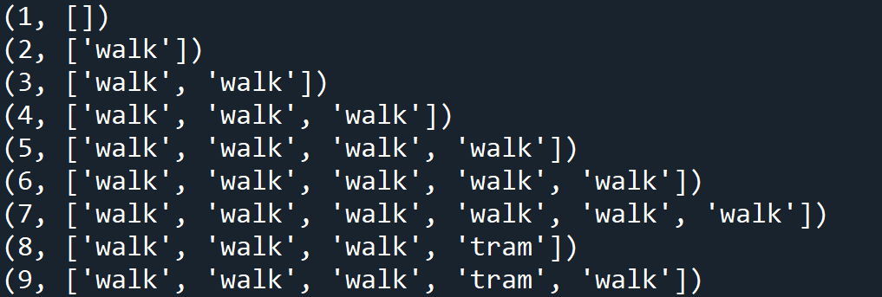
Learning Transportation Problem (N = 10)
Walk: 2, Tram: 4

Slide 49
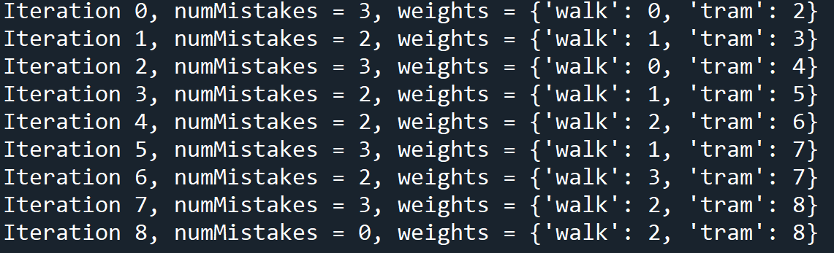
Learning Transportation Problem (N = 10)

Slide 50
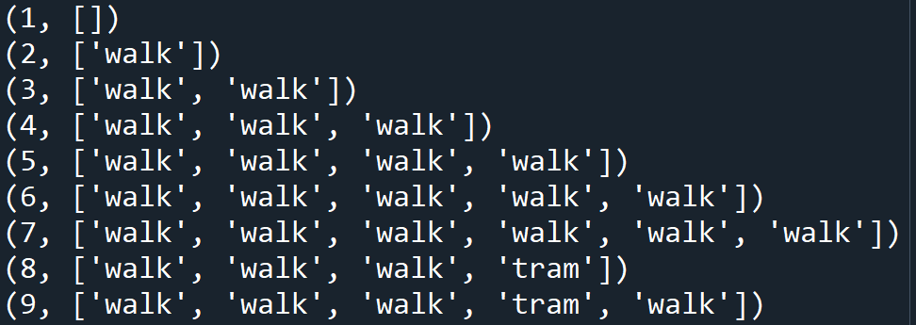
Learning Transportation Problem (N = 10)
Walk: 2, Tram: 5

Slide 51
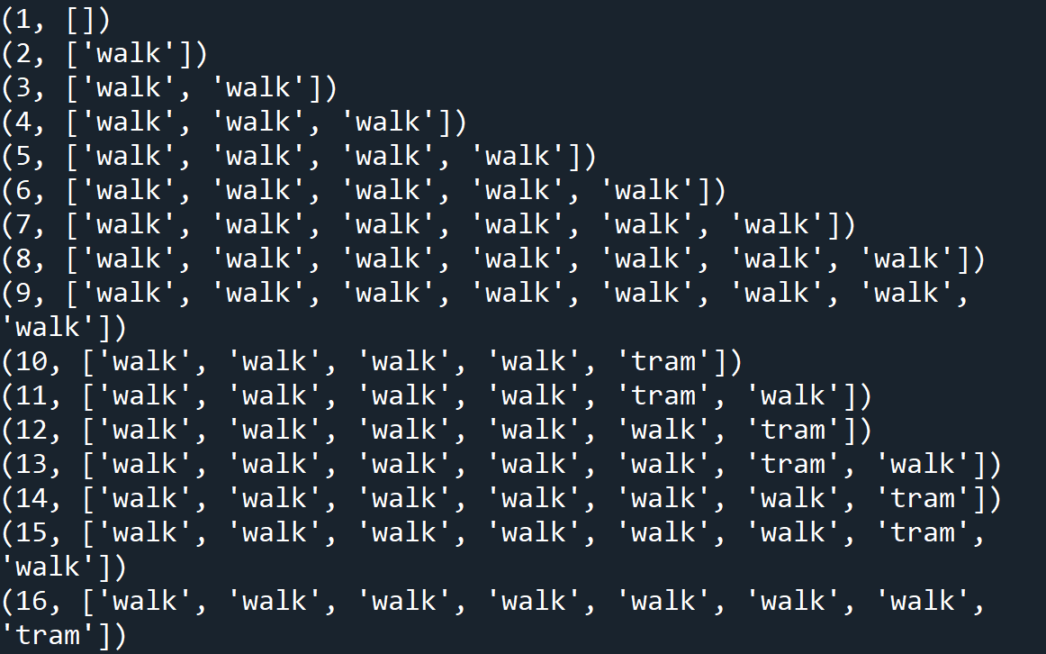

Slide 52
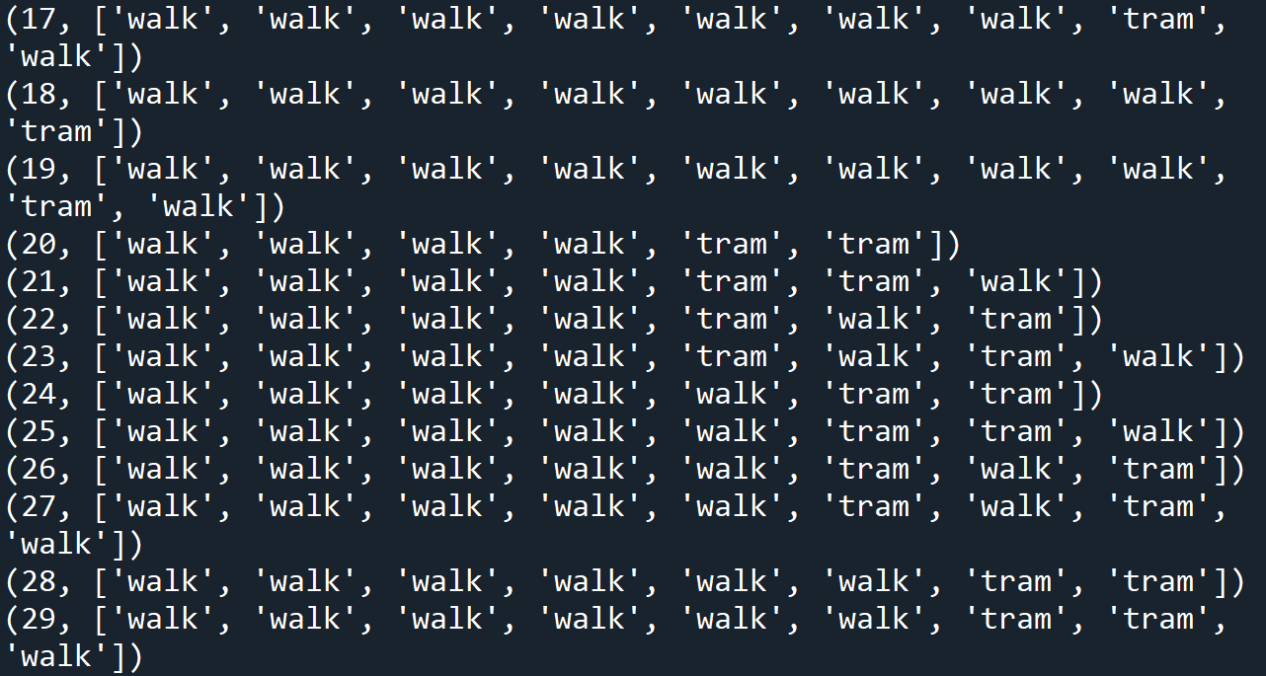

Slide 53
Learning on N= 30

Slide 54
A* Search

Slide 55


Can uniform cost search be improved?
Problem: UCS orders states by cost from s_{start} to s
Goal: take into account cost from s to s_{end}
$$s_{start}$$
$$s_{end}$$
Wasted Effort
Wasted Effort
Notes:
Now our goal is to make UCS faster. If we look at the UCS algorithm, we see that it explores states based on how far they are away from the start state. As a result, it will explore many states which are close to the start state, but in the opposite direction of the end state.
Intuitively, we’d like to bias UCS towards exploring states which are closer to the end state, and that’s exactly what A* does.

Slide 56
Exploring states
UCS: explore states in order of PastCost(s)
sstart
s
send
PastCost(s) FutureCost(s)
Ideal: explore in order of PastCost(s) + FutureCost(s) A*: explore in order of PastCost(s) + h(s)
Definition: Heuristic function
A heuristic h(s) is any estimate of FutureCost(s).
Notes:
First, some terminology: PastCost(s) is the minimum cost from the start state to s, and FutureCost(s) is the minimum cost from s to an end state. Without loss of generality, we can just assume we have one end state. (If we have multiple ones, create a new official goal state which is the successor of all the original end states.)
Recall that UCS explores states in order of PastCost(s). It’d be nice if we could explore states in order of PastCost(s) + FutureCost(s), which would definitely take the end state into account, but computing FutureCost(s) would be as expensive as solving the original problem.
A* relies on a heuristic h(s), which is an estimate of FutureCost(s). For A* to work, h(s) must satisfy some conditions, but for now, just think of h(s) as an approximation. We will soon show that A* will explore states in order of PastCost(s) + h(s). This is nice, because now states which are estimated (by h(s)) to be really far away from the end state will be explored later, even if their PastCost(s) is small.

Slide 57
A* Search
Algorithm: A* search [Hart/Nilsson/Raphael, 1968]
Run uniform cost search with modified edge costs: Cost^{j}(s, a) = Cost(s, a) + h(Succ(s, a)) − h(s)
Intuition: add a penalty for how much action a takes us away from the end state
Example:
sstart
send
E
0
A
h(s) = 4
2
B
3
2
C
2
0
D
1
0
Cost^{j}(C, B) = Cost(C, B) + h(B) − h(C) = 1 + (3 − 2) = 2
Notes:
Here is the full A* algorithm: just run UCS with modified edge costs.
You might feel tricked because we promised you a shiny new algorithm, but actually, you just got a refurbished version of UCS. (This is a slightly unorthodox presentation of A*. The normal presentation is modifying UCS to prioritize by PastCost(s) + h(s) rather than PastCost(s).) But I think the modified edge costs view shows a deeper connection to UCS, and we don’t even have to modify the UCS code at all.
How should we think of these modified edge costs? It’s the same edge cost Cost(s, a) plus an additional
term. This term is difference between the estimated future cost of the new state Succ(s, a) and that of the current state s. In other words, we’re measuring how much farther from the end state does action a take us. If this difference is positive, then we’re penalizing the action a more. If this difference is negative, then we’re favoring this action a.
Let’s look at a small example. All edge costs are 1. Let’s suppose we define h(s) to be the actual FutureCost(s), the minimum cost to the end state. In general, this is not the case, but let’s see what happens in the best case. The modified edge costs are 2 for actions moving away from the end state and 0 for actions moving towards the end state.
In this case, UCS with original edge costs 1 will explore all the nodes. However, A* (UCS with modified edge costs) will explore only the three nodes on the path to the end state.

Slide 58
Example Heuristic
Will any heuristic work?
No.
Counter example:
0
B
0
A
0
D
1000
C
Doesn’t work because of negative modified edge costs!
Notes:
So far, we’ve just said that h(s) is just an approximation of FutureCost(s). But can it be any approximation?
The answer is no, as the counterexample clearly shows. The modified edge costs would be 1 (A to B), 1002 (A to C), 5 (B to D), and -999 (C to D). UCS would go to B first and then to D, finding a cost 6 path rather than the optimal cost 3 path through C.
If our heuristic is lying to us (bad approximation of future costs), then running A* (UCS on modified costs) could lead to a suboptimal solution. Note that the reason this heuristic doesn’t work is the same reason UCS doesn’t work when there are negative action costs.

Slide 59
Consistent heuristics
Definition: consistency
A heuristic h is consistent if
Cost^{j}(s, a) = Cost(s, a) + h(Succ(s, a)) − h(s) ≥ 0
h(s_{end}) = 0.
Condition 1: needed for UCS to work (triangle inequality).
Cost(s, a)
s h(Succ(s, a))
h(s)
send
Condition 2: FutureCost(s_{end}) = 0 so match it.
Notes:
We need h(s) to be consistent, which means two things. First, the modified edge costs are non-negative (this is the main property). This is important for UCS to find the minimum cost path (remember that UCS only works when all the edge costs are non-negative).
Second, h(s_{end}) = 0, which is just saying: be reasonable. The minimum cost from the end state to the end state is trivially 0, so just use 0.
We will come back later to the issue of getting a hold of a consistent heuristic, but for now, let’s assume we have one and see what we can do with it.

Slide 60

Correctness of A*
Proposition: correctness
If h is consistent, A* returns the minimum cost path.

Slide 61
Efficiency of A*
Theorem: efficiency of A*
A* explores all states s satisfying PastCost(s) ≤ PastCost(s_{end}) − h(s)
Interpretation: the larger h(s), the better Proof: A* explores all s such that
PastCost(s) + h(s)
≤
PastCost(s_{end})
Notes:
We’ve proven that A* is correct (finds the minimum cost path) for any consistent heuristic h. But for A* to be interesting, we need to show that it’s more efficient than UCS (on the original edge costs). We will measure speed in terms of the number of states which are explored prior to exploring an end state.
Our second theorem is about the efficiency of A*: recall that UCS explores states in order of past cost, so that it will explore every state whose past cost is less than the past cost of the end state.
A* explores all states for which PastCost^{j}(s) = PastCost(s)+h(s)−h(s_{start}) is less than PastCost^{j}(s_{end}) =
PastCost(s_{end})+h(s_{end})−h(s_{start}), or equivalently PastCost(s)+h(s) ≤ PastCost(s_{end}) since h(s_{end}) = 0.
From here, it’s clear that we want h(s) to be as large as possible so we can push as many states over the PastCost(s_{end}) threshold, so that we don’t have to explore them. Of course, we still need h to be consistent to maintain correctness.
For example, suppose PastCost(s₁) = 1 and h(s₁) = 1 and PastCost(s_{end}) = 2. Then we would have to
explore s₁ (1 + 1 ≤ 2). But if we were able to come up with a better heuristic where h(s₁) = 2, then we wouldn’t have to explore s₁ (1 + 2 > 2).

Slide 62
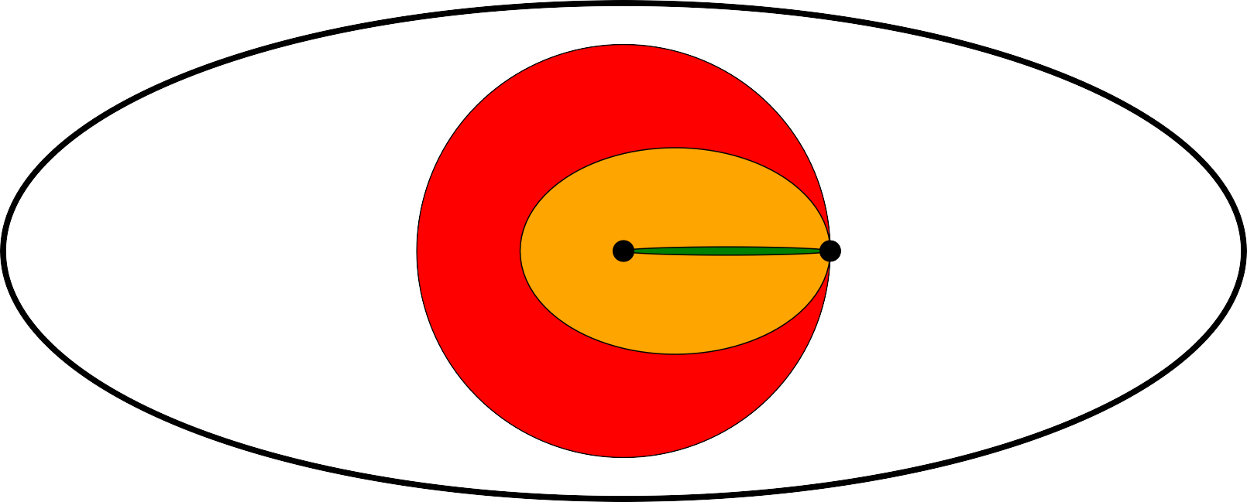
Amount explored
h = 0 (UCS)
sstart
send
h = FutureCost
If h(s) = 0, then A* is same as UCS.
If h(s) = FutureCost(s), then A* only explores nodes on a mini-
mum cost path.
Usually h(s) is somewhere in between.
Notes:
In this diagram, each ellipse corresponds to the set of states which are explored by A* with various heuristics. In general, any heuristic we come up with will be between the trivial heuristic h(s) = 0 which corresponds to UCS and the oracle heuristic h(s) = FutureCost(s) which is unattainable.

Slide 63

A* search
Key idea: distortion
A* distorts edge costs to favor end states.

Slide 64
Admissibility
Definition: admissibility
A heuristic h(s) is admissible if
h(s) ≤ FutureCost(s)
Intuition: admissible heuristics are optimistic
Theorem: consistency implies admissibility
If a heuristic h(s) is consistent, then h(s) is admissible.
Proof: use induction on FutureCost(s)
Notes:
So far, we’ve just assumed that FutureCost(s) is the best possible heuristic (ignoring for the moment that it’s impractical to compute). Let’s actually prove this now.
To do this, we just have to show that any consistent heuristic h(s) satisfies h(s) ≤ FutureCost(s) (since by the previous theorem, the larger the heuristic, the better). In fact, this property has a special name: we say that h(s) is admissible. In other words, an admissible heuristic h(s) underestimates the future cost: it is optimistic.
The proof proceeds by induction on increasing FutureCost(s). In the base case, we have 0 = h(s_{end}) ≤
FutureCost(s_{end}) = 0 by the second condition of consistency.
In the inductive case, let s be a state and let a be an optimal action leading to s^{j} = Succ(s, a) that achieves the minimum cost path to the end state; in other words, FutureCost(s) = Cost(s, a) + FutureCost(s^{j}). Since Cost(s, a) ≥ 0, we have that FutureCost(s^{j}) ≤ FutureCost(s), so by the inductive hypothesis, h(s^{j}) ≤ FutureCost(s^{j}). To show the same holds for s, consider: h(s) ≤ Cost(s, a) + h(s^{j}) ≤ Cost(s, a) + FutureCost(s^{j}) = FutureCost(s), where the first inequality follows by consistency of h(s), the second inequality follows by the inductive hypothesis, and the third equality follows because a was chosen to be the optimal action. Therefore, we conclude that h(s) ≤ FutureCost(s).
Aside: People often talk about admissible heuristics. Using A* with an admissible heuristic is only guar- anteed to find the minimum cost path for tree search algorithms, where we don’t use an explored list. However, the UCS and A* algorithms we are considering in this class are graph search algorithms, which require consistent heuristics, not just admissible heuristics, to find the minimum cost path. There are some admissible heuristics which are not consistent, but most natural ones are consistent.

Slide 65
Relaxation

Slide 66


How do we get good heuristics?
Just relax...

Slide 67

Relaxation
Intuition: ideally, use h(s) = FutureCost(s), but that’s as hard as solving the original problem.
Key idea: relaxation
Constraints make life hard. Get rid of them. But this is just for the heuristic!
Notes:
So far, given a heuristic h(s), we can run A* using it and get a savings which depends on how large h(s) is. However, we’ve only seen two heuristics: h(s) = 0 and h(s) = FutureCost(s). The first does nothing (gives you back UCS), and the second is hard to compute.
What we’d like to do is to come up with a general principle for coming up with heuristics. The idea is that of a relaxation: instead of computing FutureCost(s) on the original problem, let us compute FutureCost(s) on an easier problem, where the notion of easy will be made more formal shortly.
Note that coming up with good heuristics is about modeling, not algorithms. We have to think carefully about our problem domain and see what kind of structure we can exploit in it.

Slide 68
Relaxation overview
reduce costs
remove constraints
closed form solution
easier search
independent subproblems
combine heuristics using max

Slide 69
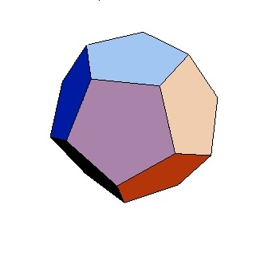

Closed form solution
Example: knock down walls
Goal: move from triangle to circle
Hard Easy
Heuristic:
h(s) = ManhattanDistance(s, (2, 5)) e.g., h((1, 1)) = 5
Notes:
Here’s a simple example. Suppose states are positions (r, c) on the grid. Possible actions are moving up, down, left, or right, provided they don’t move you into a wall or off the grid; and all edge costs are 1. The start state is at the triangle at (1, 1), and the end state is the circle at position (2, 5).
With an arbitrary configuration of walls, we can’t compute FutureCost(s) except by doing search. However, if we just relaxed the original problem by removing the walls, then we can compute FutureCost(s) in closed form: it’s just the Manhattan distance between s and s_{end}. Specifically, ManhattanDistance((r₁, c₁), (r₂, c₂)) = |r₁ − r₂| + |c₁ − c₂|.

Slide 70
Easier search
Example: original problem
Start state: 1
Walk action: from s to s + 1 (cost: 1) Tram action: from s to 2s (cost: 2) End state: n
Constraint: can’t have more tram actions than walk actions.
State: (location, #walk - #tram)
Number of states goes from O(n) to O(n²)!
Notes:
Let’s revisit our magic tram example. Suppose now that a decree comes from above that says you can’t have take the tram more times than you walk. This makes our lives considerably worse, since if we wanted to respect this constraint, we have to keep track of additional information (augment the state).
In particular, we need to keep track of the number of walk actions that we’ve taken so far minus the number of tram actions we’ve taken so far, and enforce that this number does not go negative. Now the number of states we have is much larger and thus, search becomes a lot slower.

Slide 71
Easier search
Example: relaxed problem
Start state: 1
Walk action: from s to s + 1 (cost: 1) Tram action: from s to 2s (cost: 2) End state: n
Constraint: can’t have more tram actions than walk actions.
Original state: (location, #walk - #tram) Relaxed state: location
Notes:
What if we just ignore that constraint and solve the original problem? That would be much easier/faster. But how do we construct a consistent heuristic from the solution from the relaxed problem?

Slide 72
Easier search
Compute relaxed FutureCost_{rel}(location) for each location (1, . . . , n) using dynamic programming or UCS
Example: reversed relaxed problem
Start state: n
Walk action: from s to s − 1 (cost: 1) Tram action: from s to s/2 (cost: 2) End state: 1
Modify UCS to compute all past costs in reversed relaxed problem (equivalent to future costs in relaxed problem!)
Define heuristic for original problem:
h((location, #walk-#tram)) = FutureCost_{rel}(location)
Notes:
We want to now construct a heuristic h(s) based on the future costs under the relaxed problem.
For this, we need the future costs for all the relaxed states. One straightforward way to do this is by using dynamic programming. However, if we have cycles, then we need to use uniform cost search.
But recall that UCS only computes the past costs of all states up until the end. So we need to make two changes. First, we simply don’t stop at the end, but keep on going until we’ve explored all the states. Second, we define a reversed relaxed problem (where all the edges are just reversed), and call UCS on that. UCS will return past costs in the reversed relaxed problem which correspond exactly to future costs in the relaxed problem.
Finally, we need to construct the actual heuristic. We have to be a bit careful because the state spaces of
the relaxed and original problems are different. For this, we set the heuristic h(s) to the future cost of the relaxed version of s.
Note that the minimum cost returned by A* (UCS on the modified problem) is the true minimum cost
minus the value of the heuristic at the start state.

Slide 73
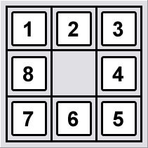
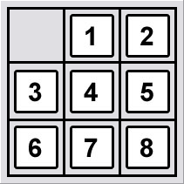
Independent subproblems
[8 puzzle]
Original problem: tiles cannot overlap (constraint) Relaxed problem: tiles can overlap (no constraint) Relaxed solution: 8 indep. problems, each in closed form
Key idea: independence
Relax original problem into independent subproblems.
Notes:
So far, we’ve seen that some heuristics h(s) can be computed in closed form and others can be computed by doing a cheaper search. But there’s another way to define heuristics h(s) which are efficient to compute.
In the 8-puzzle, the goal is to slide the tiles around to produce the desired configuration, but with the constraint that no two tiles can occupy the same position. However, we can throw that constraint out the window to get a relaxed problem. Now, the new problem is really easy, because the tiles can now move independently. So we’ve taken one giant problem and turned it into 8 smaller problems. Each of the smaller problems can now be solved separately (in this case, in closed form, but in other cases, we can also just do search).
It’s worth remembering that all of these relaxed problems are simply used to get the value of the heuristic
h(s) to guide the full search. The actual solutions to these relaxed problems are not used.

Slide 74


General framework
Removing constraints
(knock down walls, walk/tram freely, overlap pieces)
Reducing edge costs
(from ∞ to some finite cost)
Example:
Original: Cost((1, 1), East) = ∞
Relaxed: Cost_{rel}((1, 1), East) = 1
Notes:
We have seen three instances where removing constraints yields simpler solutions, either via closed form, easier search, or independent subproblems. But we haven’t formally proved that the heuristics you get are consistent!
Now we will analyze all three cases in a unified framework. Removing constraints can be thought of
as adding edges (you can go between pairs of states that you weren’t able to before). Adding edges is equivalent to reducing the edge cost from infinity to something finite (the resulting edge cost).

Slide 75
General framework
Definition: relaxed search problem
A relaxation P_{rel} of a search problem P has costs that satisfy:
Cost_{rel}(s, a) ≤ Cost(s, a).
Definition: relaxed heuristic
Given a relaxed search problem P_{rel}, define the relaxed heuristic h(s) = FutureCost_{rel}(s), the minimum cost from s to an end state using Cost_{rel}(s, a).
Notes:
More formally, we define a relaxed search problem as one where the relaxed edge costs are no larger than the original edge costs.
The relaxed heuristic is simply the future cost of the relaxed search problem, which by design should be efficiently computable.

Slide 76
General framework
Theorem: consistency of relaxed heuristics
Suppose h(s) = FutureCost_{rel}(s) for some relaxed problem P_{rel}. Then h(s) is a consistent heuristic.
Proof:
h(s) ≤ Cost_{rel}(s, a) + h(Succ(s, a)) [triangle inequality]
≤ Cost(s, a) + h(Succ(s, a)) [relaxation]
Notes:
We now need to check that our defined heuristic h(s) is actually consistent, so that using it actually will yield the minimum cost path of our original problem (not the relaxed problem, which is just a means towards an end).
Checking consistency is actually quite easy. The first inequality follows because h(s) = FutureCost_{rel}(s), and all future costs correspond to the minimum cost paths. So taking action a from state s better be no better than taking the best action from state s (this is all in the search problem P_{rel}).
The second inequality follows just by the definition of a relaxed search problem.
The significance of this theorem is that we only need to think about coming up with relaxations rather than worrying directly about checking consistency.

Slide 77
Trade Off
Efficiency:
h(s) = FutureCost_{rel}(s) must be easy to compute Closed form, easier search, independent subproblems
Tightness:
heuristic h(s) should be close to FutureCost(s) Don’t remove too many constraints
Notes:
How should one go about designing a heuristic?
First, the heuristic should be easy to compute. As the main point of A* is to make things more efficient, if the heuristic is as hard as to compute as the original search problem, we’ve gained nothing (an extreme case is no relaxation at all, in which case h(s) = FutureCost(s)).
Second, the heuristic should tell us some information about where the goal is. In the extreme case, we relax all the way and we have h(s) = 0, which corresponds to running UCS. (Perhaps it is reassuring that we never perform worse than UCS.)
So the art of designing heuristics is to balance informativeness with computational efficiency.

